Slide 2
Roma
Studying in Rome? A Unique Opportunity!
Grab this chance to immerse yourself in a 2,796 years old city where you can see the passing of time simply by strolling across its streets: ancient times, Middle-Age, Renaissance, Baroque, Neoclassicism and Modern Rome are ready to be discovered.

Slide 3
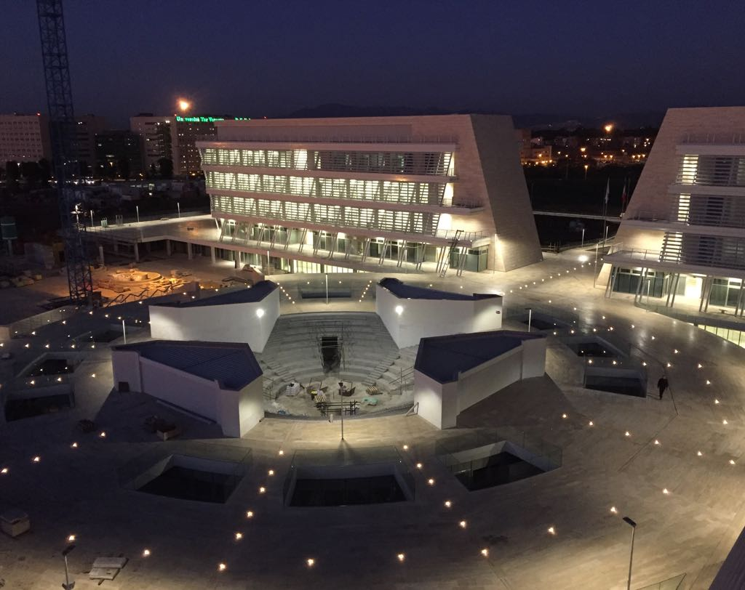
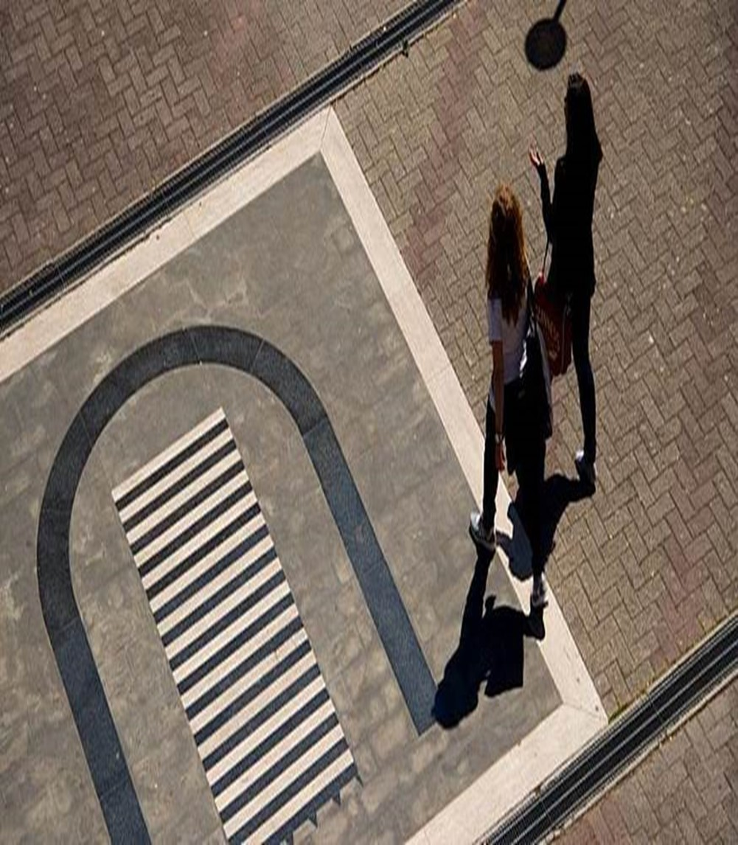
Tor Vergata
TOR VERGATA
Tor Vergata («uniroma2.it») is in the south-eastern part of Rome, Italy, 35 minutes away from the center of the city.
33.000 STUDENTS, 10% foreign
6 FACULTIES
Humanities and Philosophy, Economics, Engineering, Law, Medicine, Sciences.
RANKING
Born more than 30 years go, our University is ranked in the world QS World’s Top 70 under 50 years old institutions. And now Times Higher Education Top 100!

Slide 4
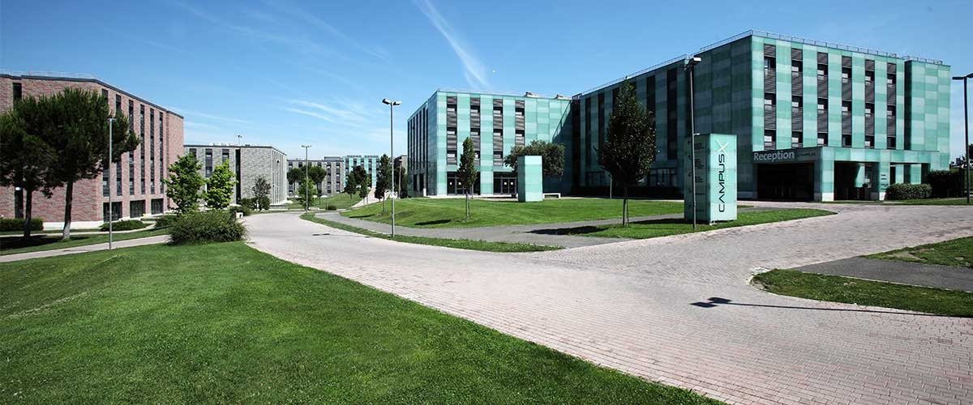
Where
Lectures will take place in our Campus and students will be housed at our modern CampusX (double-room with private bathroom and free wi-fi connection).
Tor Vergata
Campus X

Slide 5
Summer School Structure
1-week Programme
Morning – Basic Italian Lectures (15 hours)
Listening and Speaking Skills
Afternoon – cultural tours
Students will be guided and will discover Rome from late antiquity to the present

Slide 6
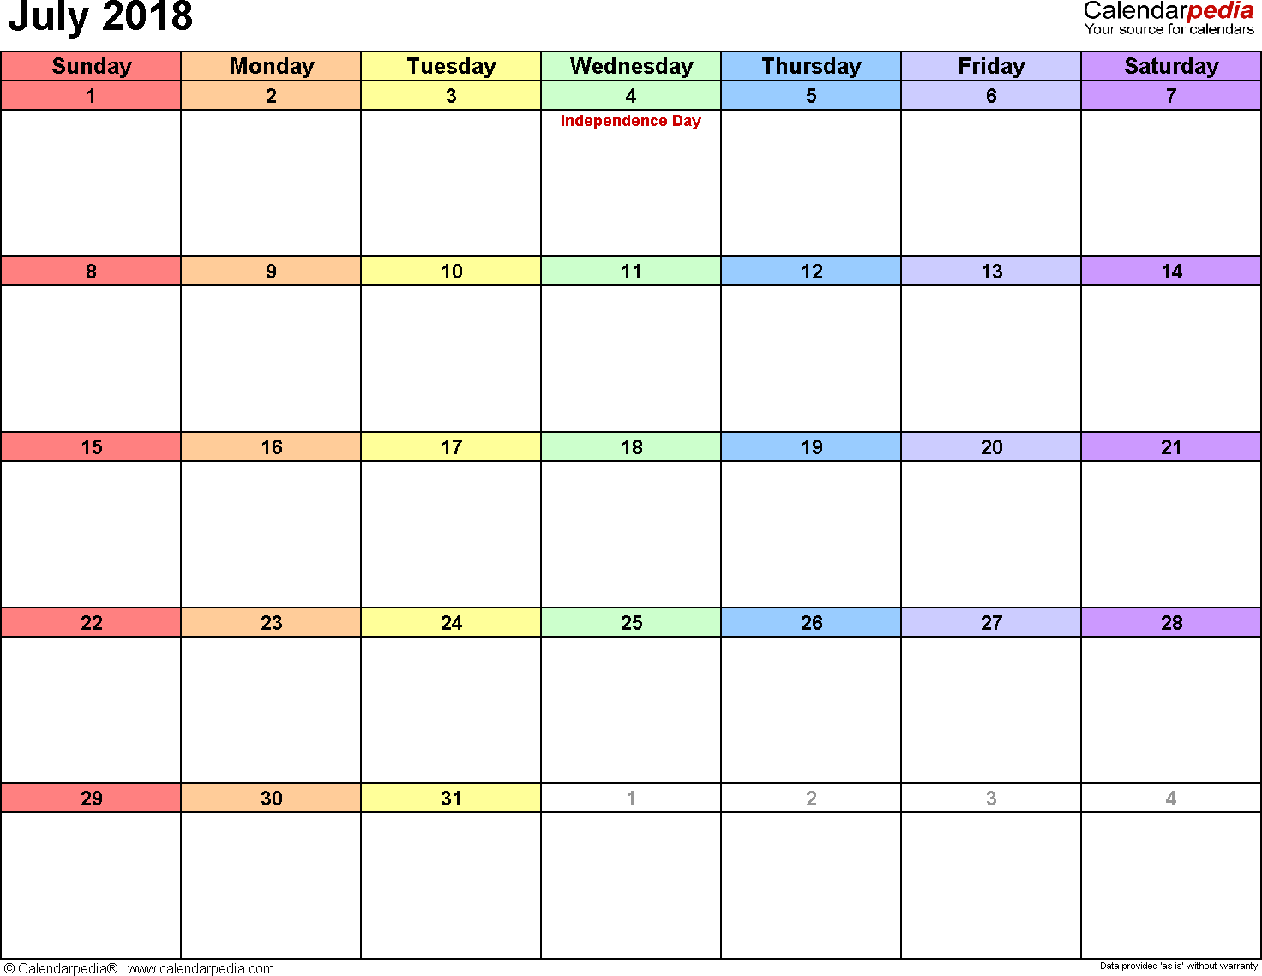
Schedule and Costs
1st – 7th July
Min 10, max 30 students with 2 accompanying teachers from Cyprus high schools
700 € per student from 10 to 15 or 600€ from 16 to 30 including:
Lectures and Class Material
Accommodation (double-bed rooms)
Transfers
Contact: chiara.tranquilli@uniroma2.it

Slide 7
Thank you!

